Slide 1
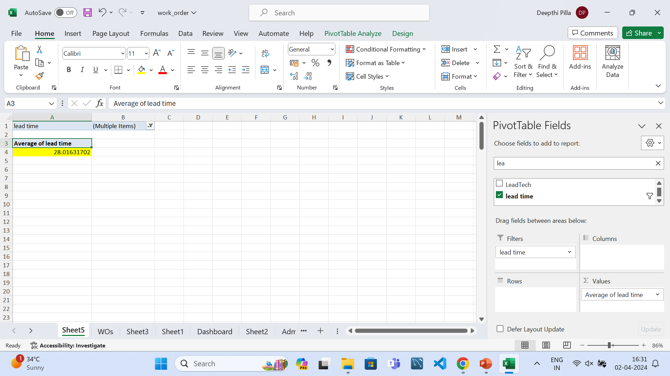
Case study Q1)
Inference:
I have observed the average lead time between the request date and completion date is 28 days.

Slide 2
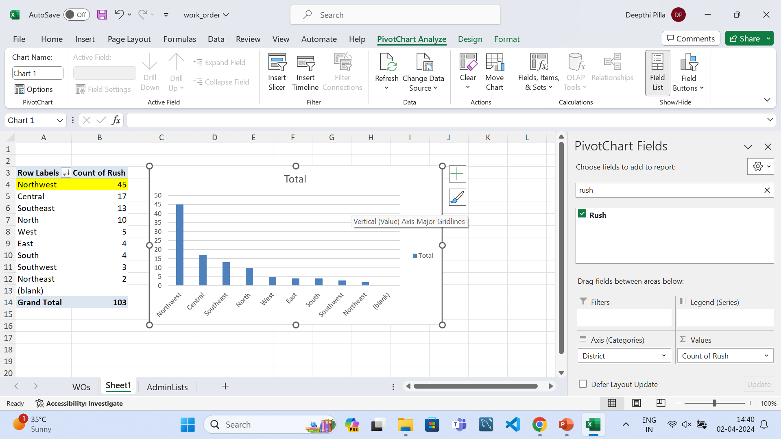
Case study Q2)
Inference:
I have observed that the North West region is having the highest number of rush jobs which is 45 based on the bar chart.

Slide 3
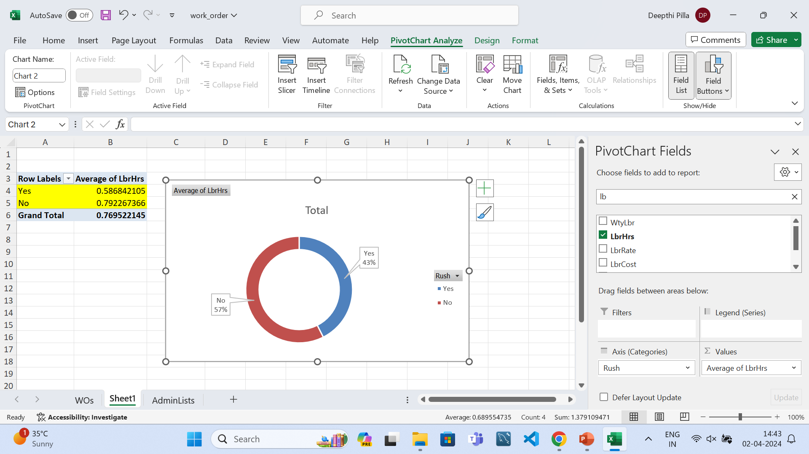
Case study Q3)
Inference:
I have observed that rush job and average labour hours vary inversely.
The rush jobs are having less average labours which is 0.58,whereas the non-rush jobs are having more average labour hours.

Slide 4
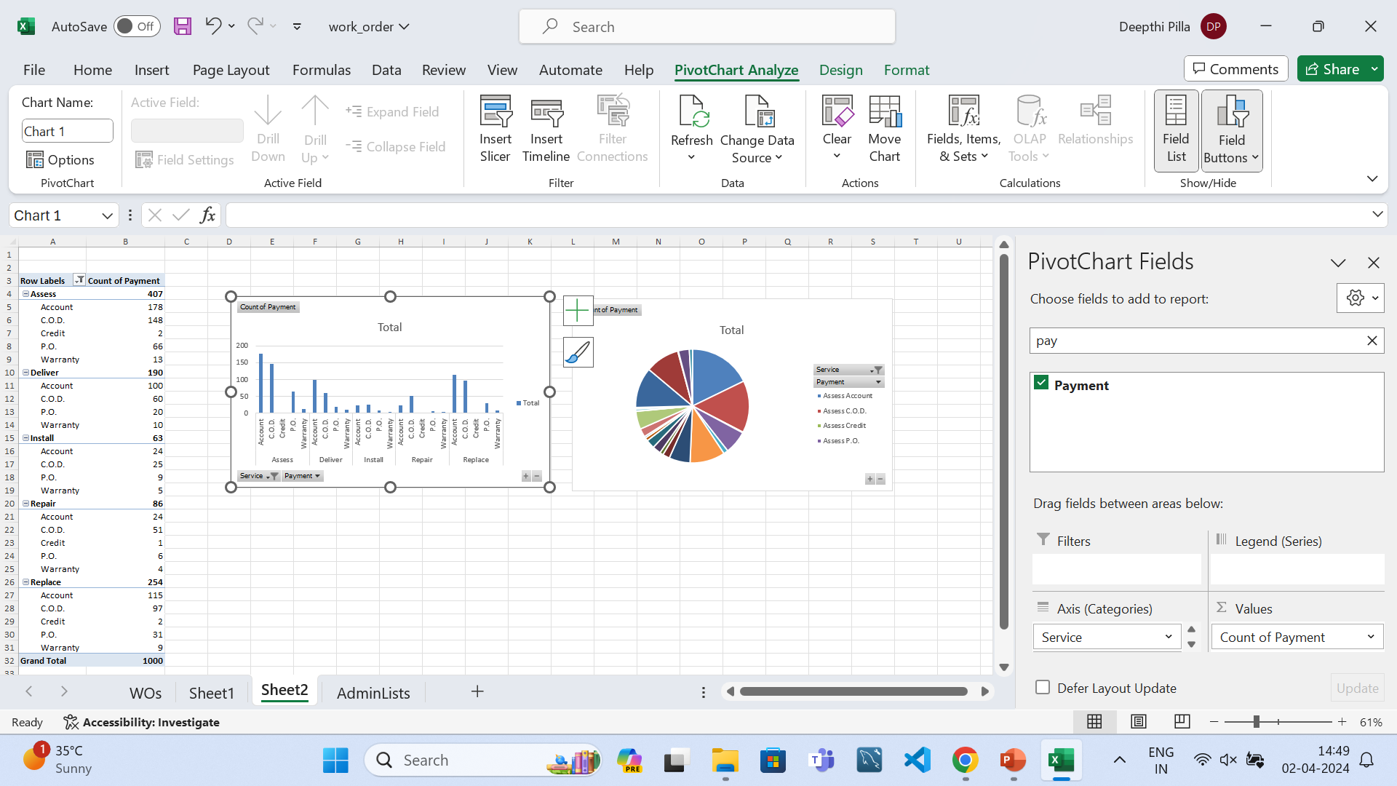
Case study Q4)
Inference:
I have observed that assess is the service type that has more payments and most of the payments are done through Account mode.

Slide 5
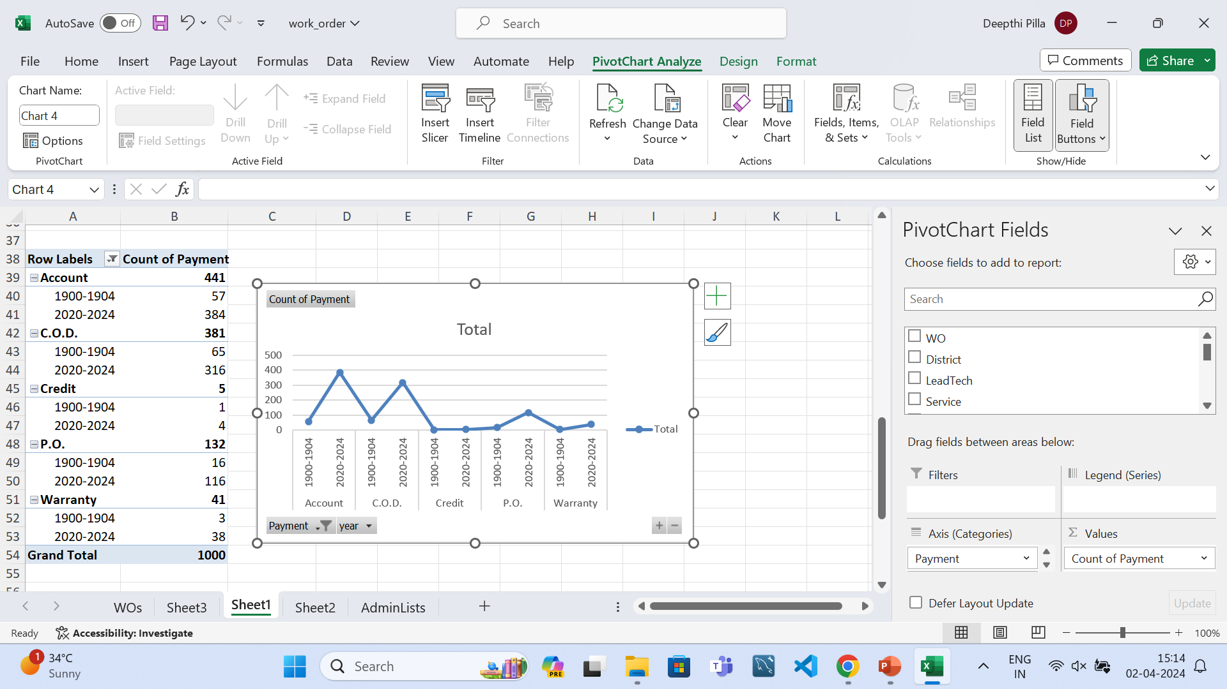
Case study Q5)
Inference:
I have observed payment types account,c.o.d,p.o,warranty have increased with time and payment mode credit is stable
With time.

Slide 6
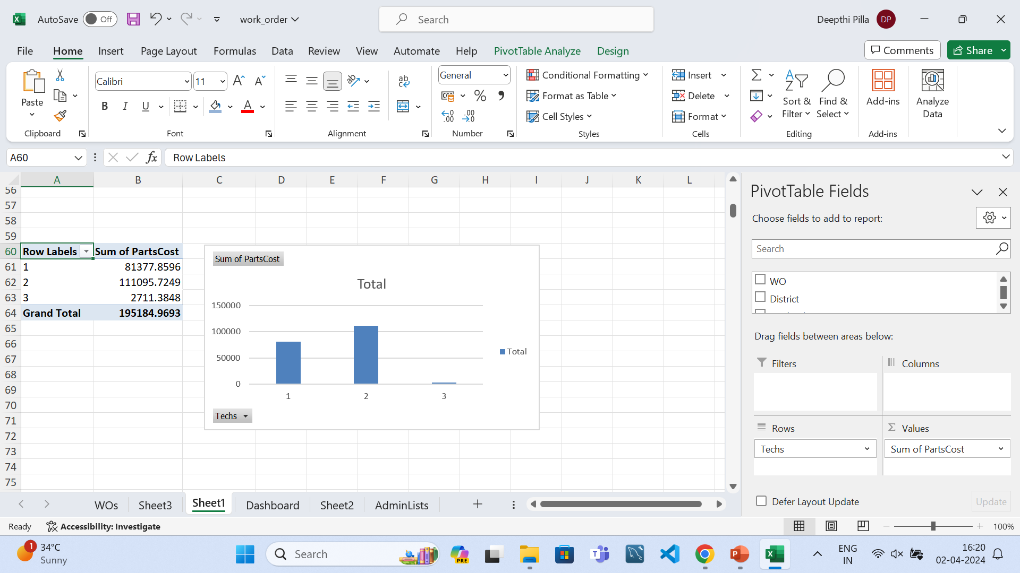
Case study Q6)
Inference:
I have observed the relation between number of technicians and cost of parts.

Slide 7
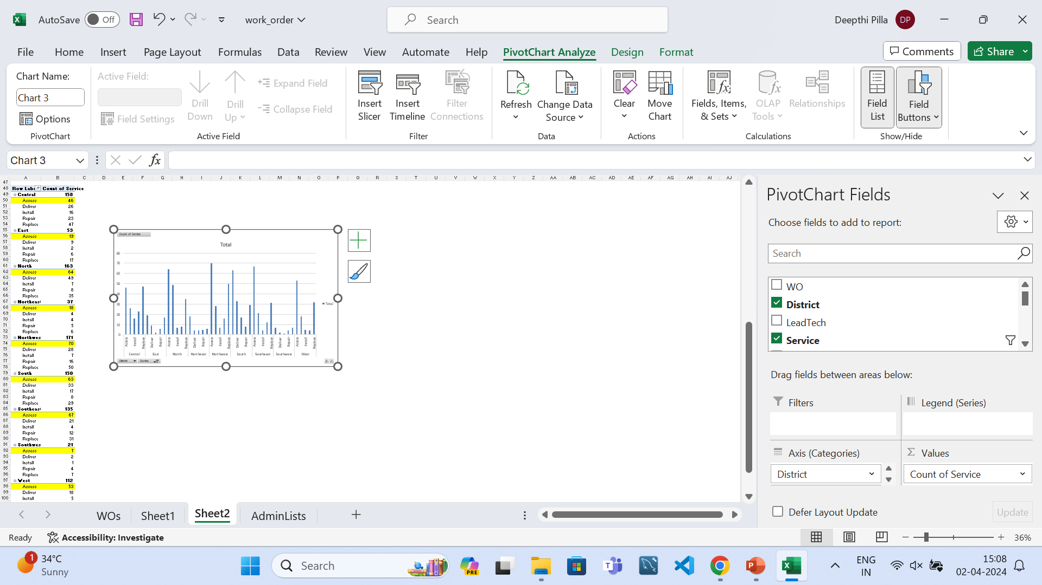
Case study Q7)
Inference:
I have observed that the most common service request from each district is Assess based on the chart here.

Slide 8
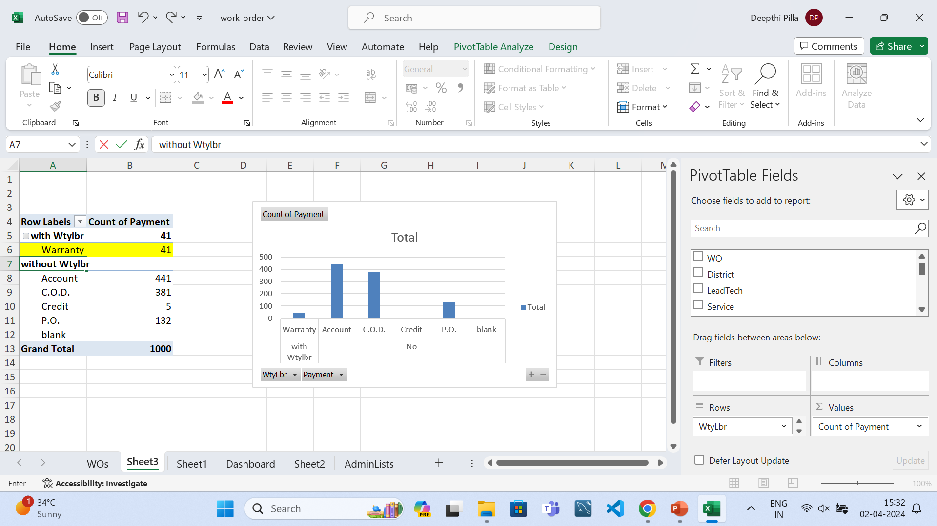
Case study Q8)
Inference:
I have observed that with warranty labour the payment mode warranty is used and without warranty labour,the other payment modes are used.

Slide 9
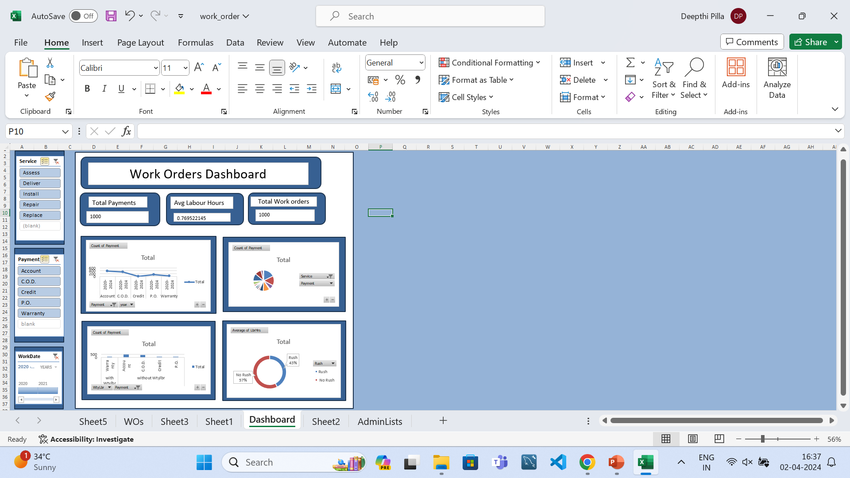
Dashboard

Slide 10
Inference From Work Orders Dashboard:
Following are some of the inferences that I have observed from dashboard:
distribution of rush jobs in different regions and rush job frequency
Relation between rush jobs and avg work hours of labour
Relation between service modes and payment methods
The total number of payments were 1000
The total number of services were 1000
Total sales is Rs 268297.5
Total no.of Work orders is 1000
Total parts cost is Rs 195185

